Slide 1
ROUTING INFORMATION PROTOCOL -by Hitesh Nautiyal

Slide 2
Routing Information Protocol :-
The RIP (Routing Information Protocol) is a distance-vector routing protocol. Routers that use the distance-vector protocol send all or a portion of their routing tables to their neighbors in routing-update messages. The Routing Information Protocol employs a distance vector algorithm to determine which path a packet should take to reach its destination. Each RIP router maintains its routing table, which lists all the destinations the router knows how to reach. In every 30 seconds, each router broadcasts its whole routing table to its closest neighbors.

Slide 3
How Hop-Count Determined :-
The hop count can be defined as the number of routers between the source and destination networks. The path with the least hops is considered the optimal route to a network, so it is added to the routing table. RIP avoids routing loops by minimizing the number of hops between the source and destination. The maximum hop count for Routing Information Protocol is 15, and a hop count of 16 indicates that the network is inaccessible.
In the diagram sheet 4, when router 1 sends a packet to router 2, it counts as one hop. Similar to this, when the packet is forwarded from router 2 to router 3, it counts as 2 hops, and when it is forwarded from router 3 to router 4, it counts as 3. Similarly, RIP can accommodate a maximum of 15 hops, so 16 routers can be configured in a RIP.

Slide 4
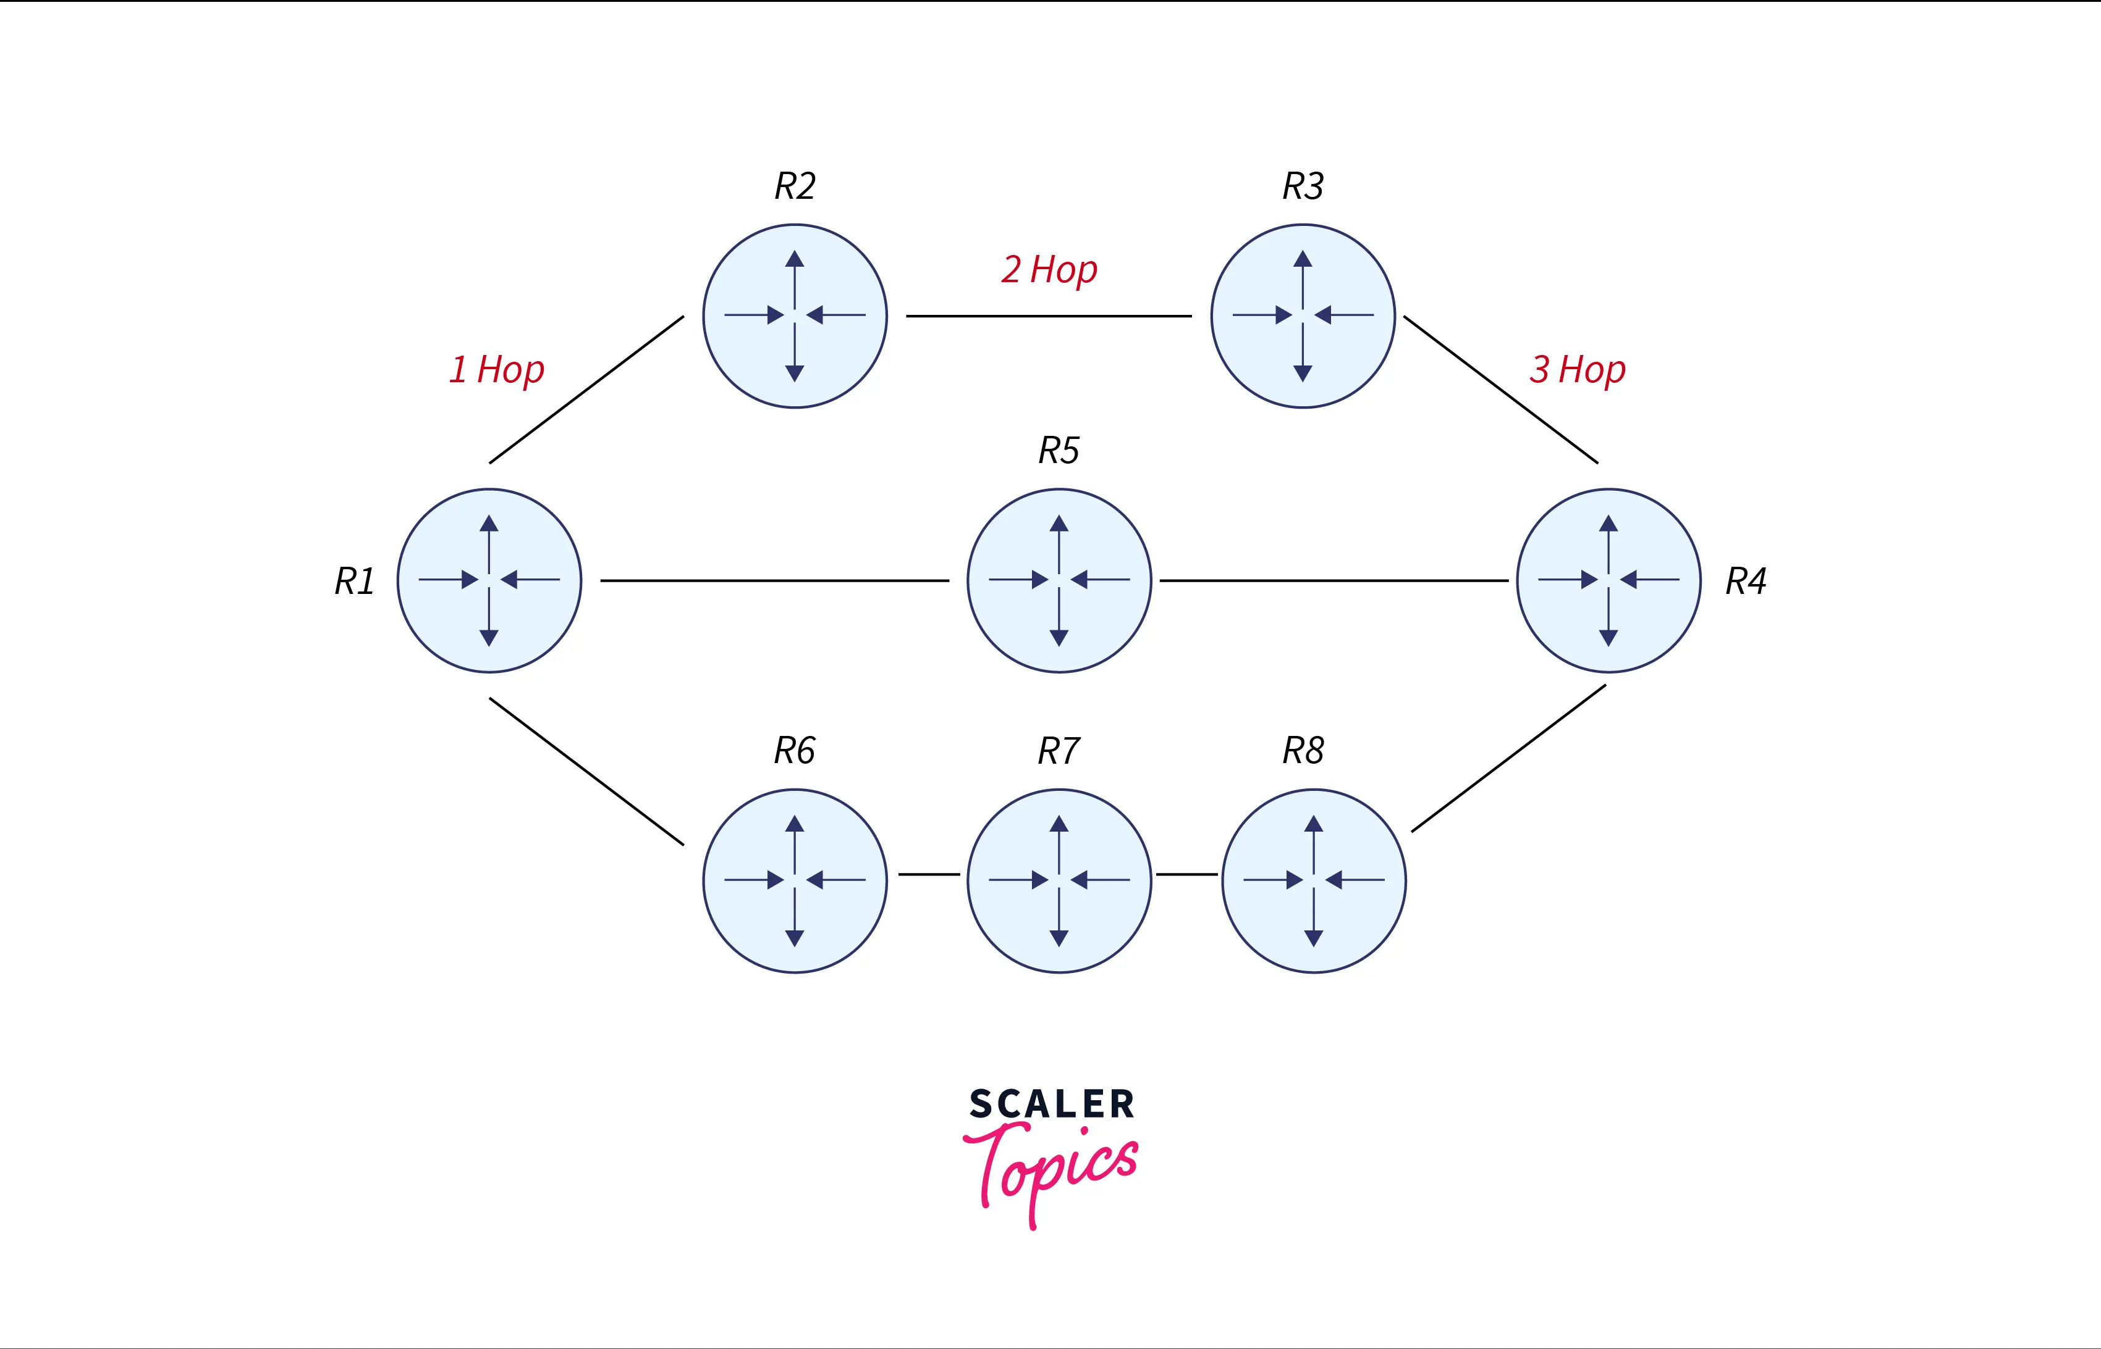
Diagram of Previous Sheet :-

Slide 5
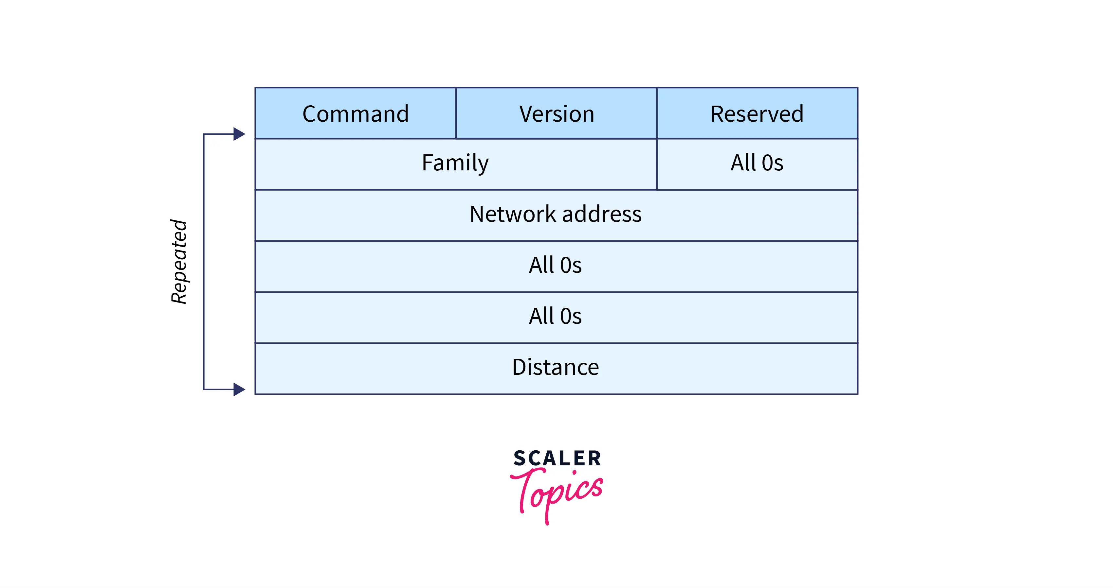
RIP MESSAGE FORMAT :-

Slide 6
Explain RIP Message Format :-
Command:- For requests or responses, this 8-bit field is used. The request has a value of 1, while the response has a value of 2.
Version:- The version in this context refers to the protocol version that we are utilizing. Assuming we are using version 1 of the protocol, we enter 1 in this box.
Reserved:- It is a reserved field, so it is concatenated with zeroes.
Family:- This field has 16 bits. Since we use the TCP/IP family, we entered the value 2 in this box.
Network Address:- It is specified as a 14-byte field. If we utilize IPv4, we use 4 bytes; the remaining 10 are zeros.
Distance:- The hop count, or the number of hops required to reach the destination, is specified in the distance field.

Slide 7
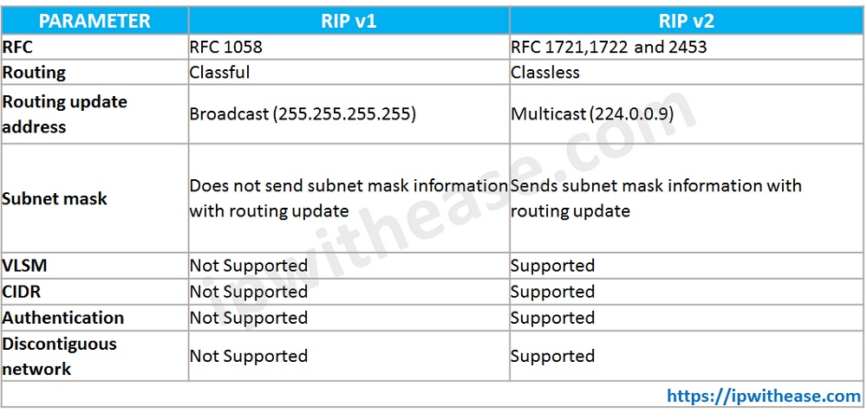
RIPv1 & RIPv2 :-

